Slide 1

Big Data in Modern Industry
Exploring enterprise demands, core data tasks, and why the R programming curriculum empowers future data leaders.

Slide 2
Industry Focus on Big Data
How modern enterprises leverage high-velocity datasets for strategic intelligence and competitive advantage.

Slide 3

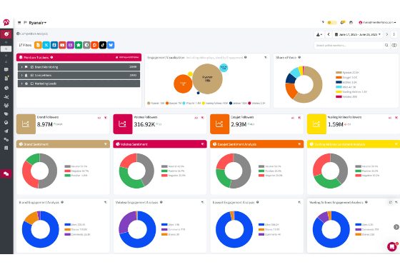
The Enterprise Data Explosion
Global organizations process petabytes of transactional, log, and cloud sensor data daily.
Data-driven firms are 23 times more likely to acquire customers and 6 times as likely to retain them.
Industry focus has shifted from simple data storage to real-time analytics and predictive capabilities.
Employers demand specialists who combine deep statistical grounding with big-data computing tools.

Slide 4


Core Industry Data Tasks
Data Ingestion & Wrangling
Exploratory & Predictive Modeling
Extracting unstructured and structured data from cloud warehouses, SQL databases, and JSON streams. Cleaning missing values, removing anomalies, and partitioning datasets for high-efficiency processing.
Performing rigorous statistical analyses to identify trends, developing machine learning pipelines (regression, classification, forecasting), and validating algorithm performance on massive samples.

Slide 5






Essential Technical Competencies
Data Manipulation
Statistical Rigor
Visual Storytelling
High-speed subsetting, aggregation, and joining of multi-gigabyte datasets using memory-optimized engines.
Applying hypothesis testing, regression models, and time-series analysis to prove cause-and-effect patterns.
Building clear, static, and dynamic visualizations that convey complex statistical results to executive stakeholders.

Slide 6

End-to-End Analytics Workflow
From Raw Logs to Business Action
Industry data practitioners must automate the entire analytics lifecycle. Modern tasks require writing clean, reproducible scripts that connect directly to distributed data stores.
Teams depend on standardized coding environments where data extraction, modeling, and automated report generation occur seamlessly.

Slide 7

Big Data Market Demand
High ROI on Skilled Talent
84%
Over 84% of Fortune 500 companies have launched advanced analytics projects to optimize supply chains, mitigate financial risk, and personalize customer experience.
Demand for professionals fluent in R and big data frameworks continues to outpace traditional business roles by more than 25% annually.
Enterprise Adoption

Slide 8






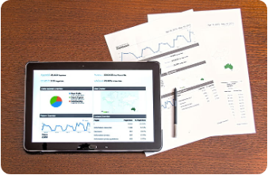

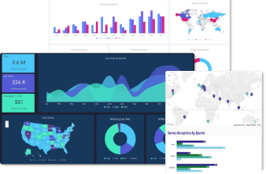
Pillars of the R Language Curriculum
1. Fast Wrangling with dplyr & data.table
2. Advanced Statistical & Predictive Modeling
3. Publication-Quality Viz via ggplot2 & Shiny

Slide 9
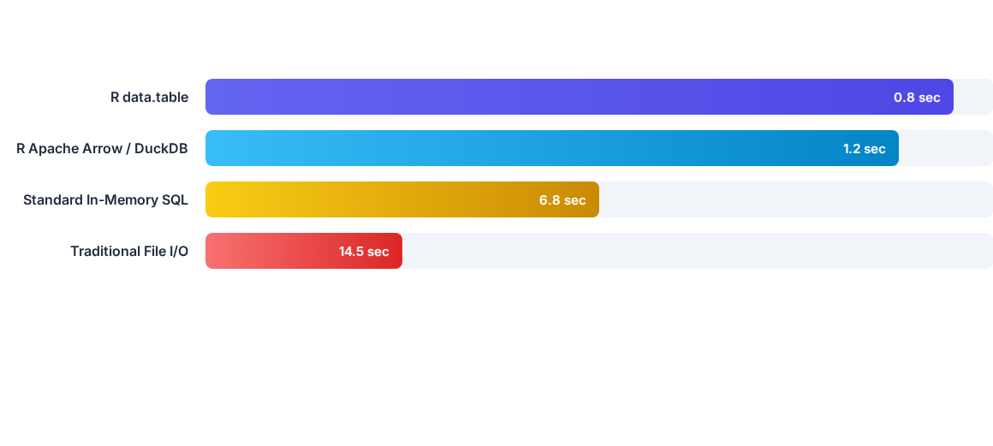
R Big Data Processing Efficiency
Benchmarks highlight how modern R packages like data.table, arrow, and duckdb process 50 million rows of data in sub-second time directly on local workstations.

Slide 10




R Curriculum Learning Roadmap
Module 2: High-Speed Wrangling
Module 4: Deployment & Viz
Mastering data.table, complex joins, piping, and dataset restructuring.
Building ggplot2 graphics, interactive Shiny apps, and machine learning pipelines.
Module 1: R Fundamentals
Module 3: Big Data Engine
Syntax, data structures, vectors, data frames, and Tidyverse workflow basics.
Connecting R to Apache Arrow, DuckDB, Sparklyr, and SQL databases.

Slide 11
Why Industry Values R
R remains the gold standard for statistical rigor, reproducible analysis, and turning complex datasets into clear executive insights.
"
"
— Lead Enterprise Data Scientist

Slide 12
Questions & Discussion
Thank you for exploring the Big Data R Curriculum.

Slide 13





Image Sources
https://www.mentionlytics.com/wp-content/uploads/2025/06/Competitive-analysis-dashboard.png
Source: www.mentionlytics.com
https://talentoindia.com/blog/wp-content/uploads/2025/09/Data-Scientist-analyzing-Python-code-and-data-visualizations-on-multiple-screens.jpeg
Source: talentoindia.com
https://uop.scene7.com/is/image/phoenixedu/blog-hero-hands-typing-on-laptop-with-data-code-and-charts.webp?fmt=webp-alpha&qlt=70&fit=constrain,1&wid=700
Source: www.phoenix.edu
https://i1.pickpik.com/photos/526/868/890/analysis-analytics-business-chart-preview.jpg
Source: www.pickpik.com
https://www.clicdata.com/wp-content/uploads/2025/03/dashboards-sample-1-1024x829.webp
Source: www.clicdata.com

